Slide 1
CSE291 - Introduction To Software Engineering (FALL 2022)
Use Case Diagrams-Relationships

Slide 2
Use Case Diagrams - Relationships
There can be 5 relationship types in a use case diagram.
Association between actor and use case
Generalization of an actor
Generalization of a use case
Extend between two use cases
Include between two use cases

Slide 3
Use Case Diagrams - Relationships
Inclusion
Inclusion enables to reuse one use case's steps inside another use case.
Extension
Allows creating a new use case by adding steps to existing use cases
Generalization
Allows child use cases to inherit behavior from parent use cases

Slide 4
Association Between Actor and Use Case
An actor must be associated with at least one use case.
An actor can be associated with multiple use cases.
Multiple actors can be associated with a single use case.

Slide 5
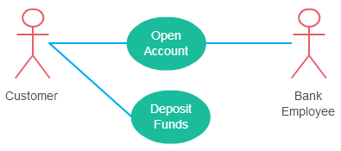
Association Between Actor and Use Case

Slide 6
Generalization of an Actor
Generalization of an actor means that one actor can inherit the role of an other actor.
The descendant inherits all the use cases of the ancestor.

Slide 7
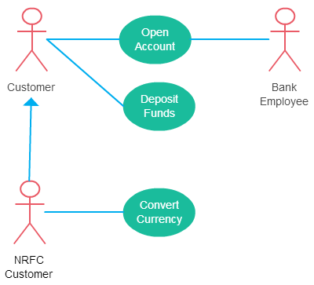
Generalization of an Actor

Slide 8
Use Case Example (Actor-to-Actor relationship)
student
graduate
student
non-graduate
student

Slide 9
Generalization of a Use Case
This is similar to the generalization of an actor.
The behavior of the ancestor is inherited by the descendant.
This is used when there are common behavior between two use cases and also specialized behavior specific to each use case.
For example in the previous banking
example there might be an use case
called “Pay Bills”. This can be generalized
to “Pay by Credit Card”, “Pay by
Bank Balance” etc.
parent
child

Slide 10
Generalization of a Use Case Example
registration
non-graduate
registration
graduate
registration

Slide 11
Extend Relationship Between Two Use Cases
As the name implies it extends the base use case and adds more functionality to the system. Here are few things to consider when using the <<extend>> relationship.
The base use case may stand alone.
The extending use case is dependent on the base use case. In the next diagram the “Calculate Bonus” use case doesn’t make much sense without the “Deposit Funds” use case.
The extending use case is usually optional and can be triggered conditionally. In the diagram you can see that the extending use case is triggered only for deposits over 10,000 or when the age is over 55.

Slide 12
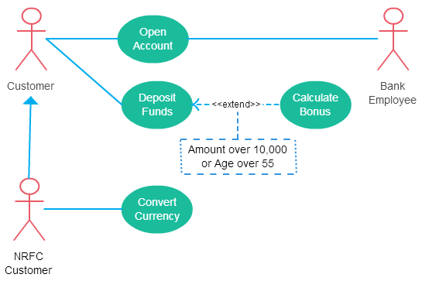
Extend Relationship Between Two Use Cases

Slide 13
Include Relationship Between Two Use Cases
Include relationship show that the behavior of the included use case is part of the including (base) use case.
The included use case never stands alone.
In some situations this is done to simplify complex behaviors.
Few things to consider when using the <<include>> relationship.
The base use case is incomplete without the included use case.
The included use case is mandatory and not optional.

Slide 14
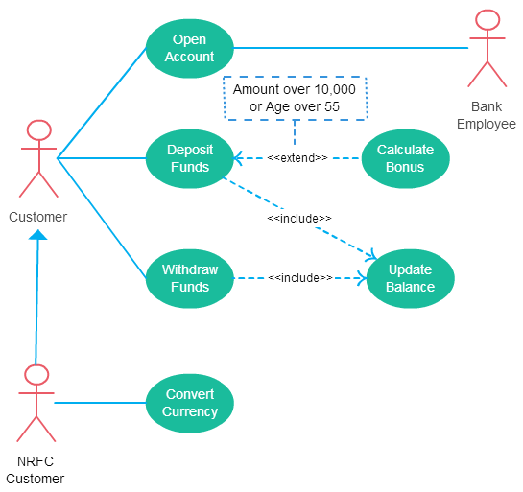
Include Relationship Between Two Use Cases

Slide 15
Case Study 1
Consider the online shopping case. The system provides the following functions:
Registered Customers uses some web site to make purchases online. Top level use cases are View Items, Make Purchase and Client Register. View Items use case could be used by new customers if they wants to find and see some products. This use case could also be used as a part of Make Purchase use case. Client Register use case allows customer to register on the web site, for example to get some coupons or be invited to private sales. Note, that Checkout use case is included use case not available by itself - checkout is part of making purchase.
Draw its use case diagram.

Slide 16
Case Study 2
Consider the Airport Check-In and Security Screening. The system provides the following functions:
Actors are Passenger, Tour Guides, Minor (Child), Passenger with Special Needs (e.g. with disabilities), all playing external roles in relation to airport business.
Business use cases are Individual Check-In, Group Check-In (for groups of tourists), Security Screening, etc. - representing business functions or processes taking place in airport and serving the needs of passengers. Business use cases Baggage Check-in and Baggage Handling extend Individual Check-In use case, because passenger might have no luggage, so baggage check-in and handling are optional.

